Slide 1
Welcome

Slide 2
“Old Maid, new tricks - Backdooring Linux Full Disk Encryption for remote forensic password recovery”
Bsides Basingstoke (2024-07-19) ~ Presented by Tom Cope

Slide 3

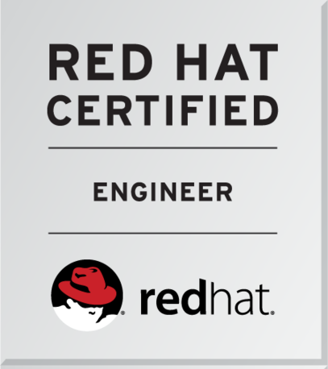



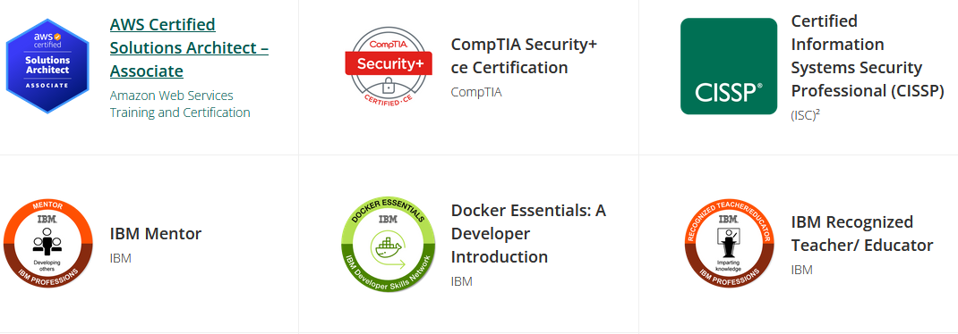
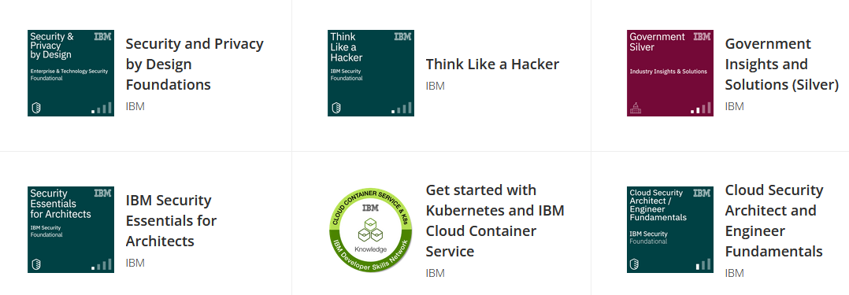
Hello World!
Tom Cope (https://tomcope.com)
Presenting in a personal capacity
Working in Cyber Security ~12 years
MSc in Software and Systems Security
CISSP
Very Part time Security Researcher (CVE-2020-5014 + CVE-2021-29707)
Mostly Blue team, writes red team tools on the weekend

Slide 4
What we covering and why?
Why?
Lot of cool concepts
Good security work done by smart people which is not common knowledge
Fun in the “quirks”
What the Evil Maid attack is?
BIOS vs UEFI
Linux boot process and its quirks
Full Disk Encryption and its quirks
Trusted Platform Module and its quirks
Secure Boot and its quirks
Putting everything together to backdoor modern Linux Disk encryption

Slide 5
Refresher - “What is a Evil Maid Attack” ?
Refers to a attack performed on a (usually powered off) unattended device
Term was coined by security analyst Joanna Rutkowska in their blog “Evil Maid goes after TrueCrypt!” [1]
Tampering with BIOS, UEFI, Disk Encryption, OS Boot Process, Trust Chains etc…
Related is the “Cold Boot” attack - Using a spray to cool down the RAM chips of a running system in order to “freeze the bits in time” and then attach the RAM to another system to extract the encryption key memory
[1] https://theinvisiblethings.blogspot.com/2009/10/evil-maid-goes-after-truecrypt.html

Slide 6
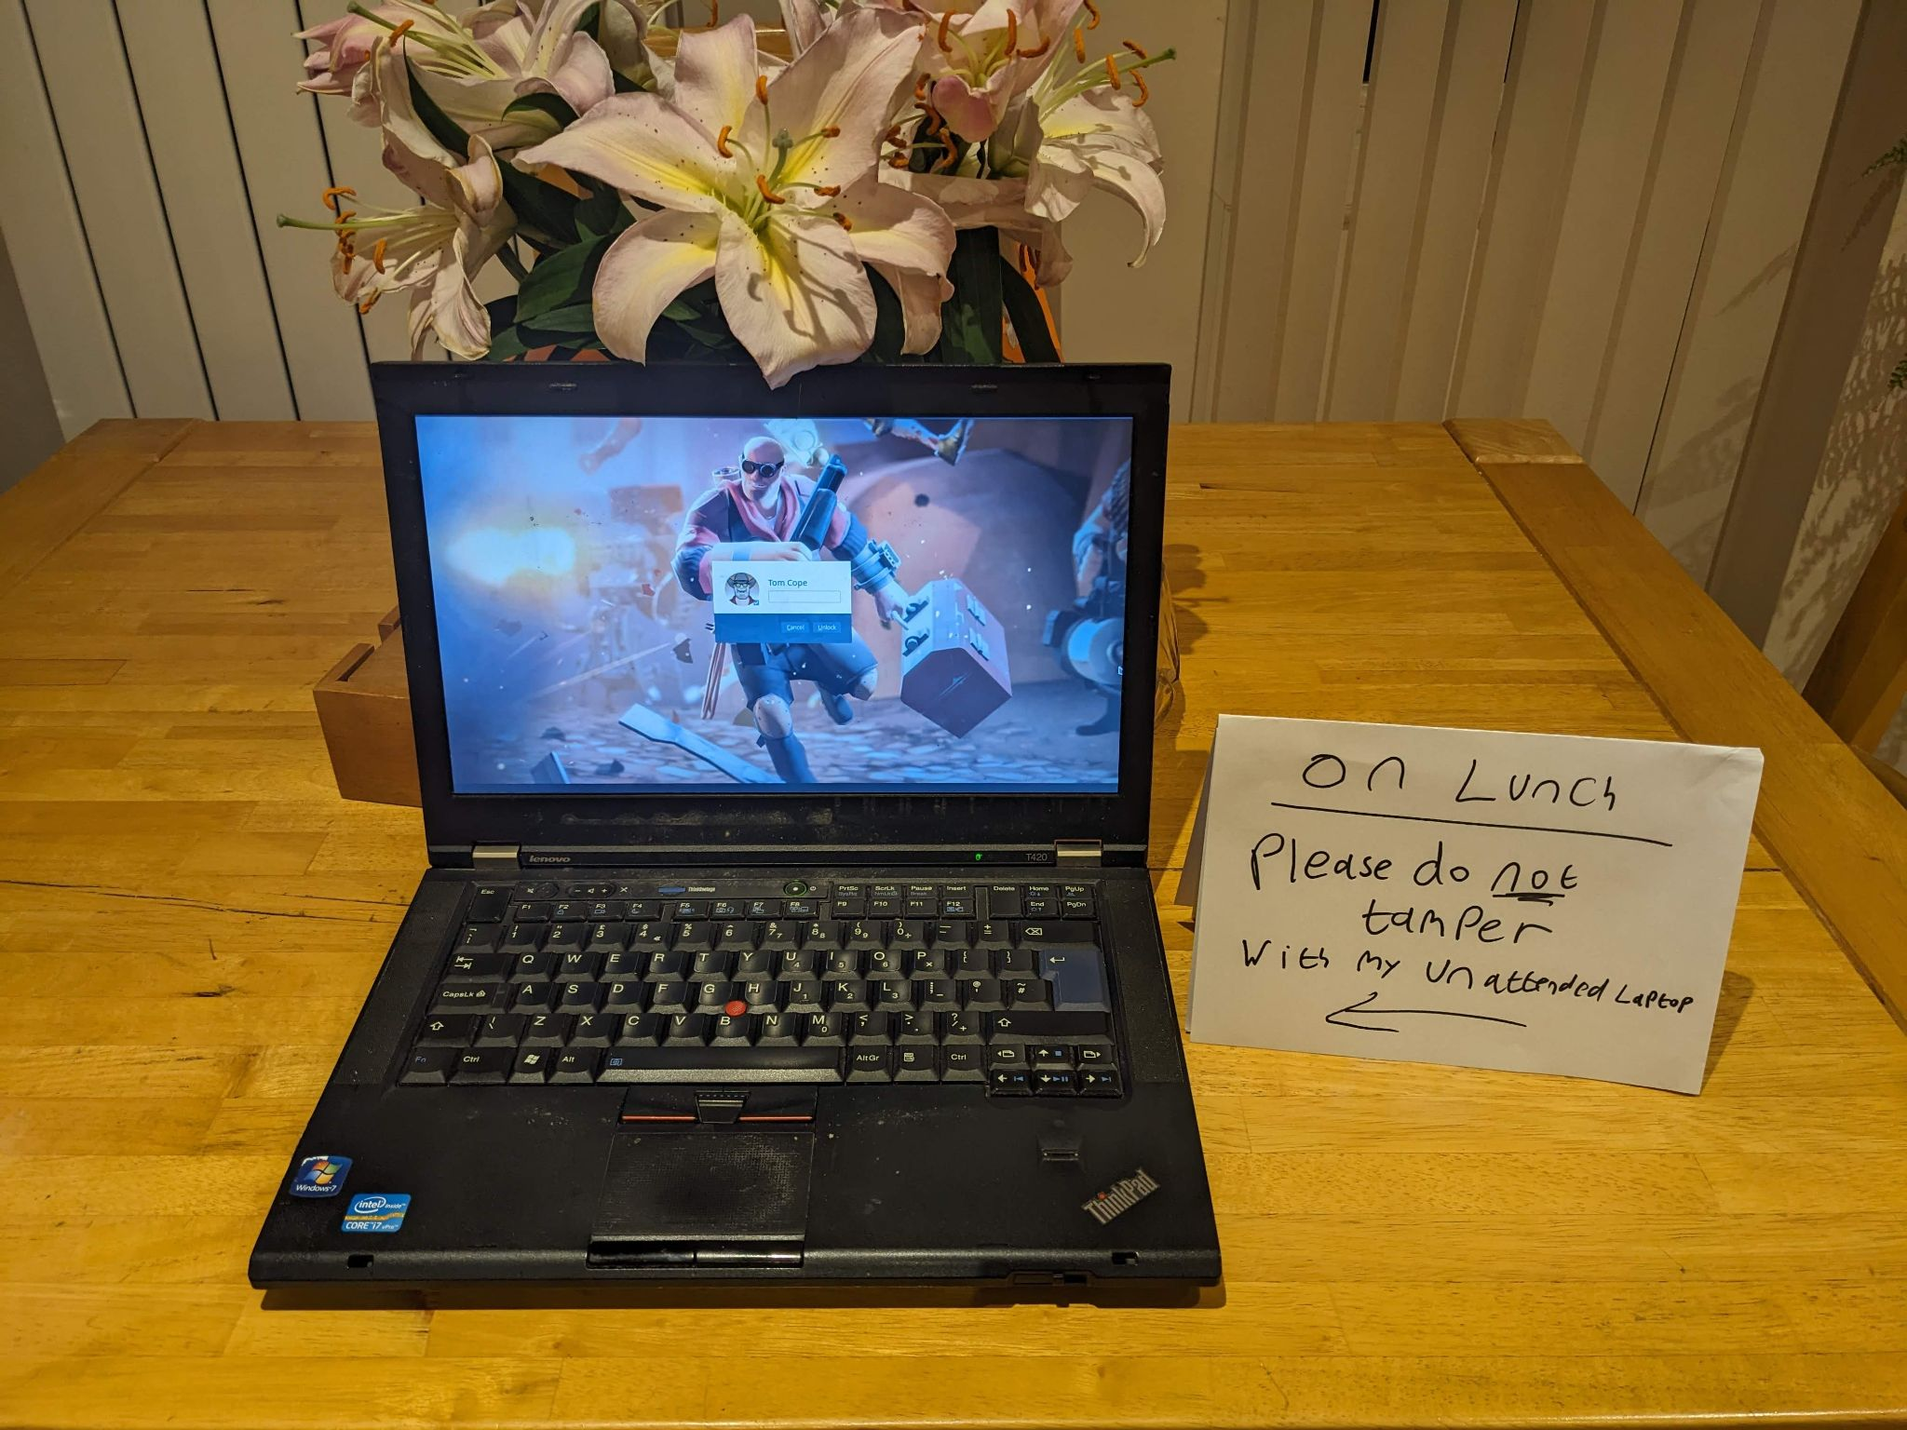
But Powered off…

Slide 7
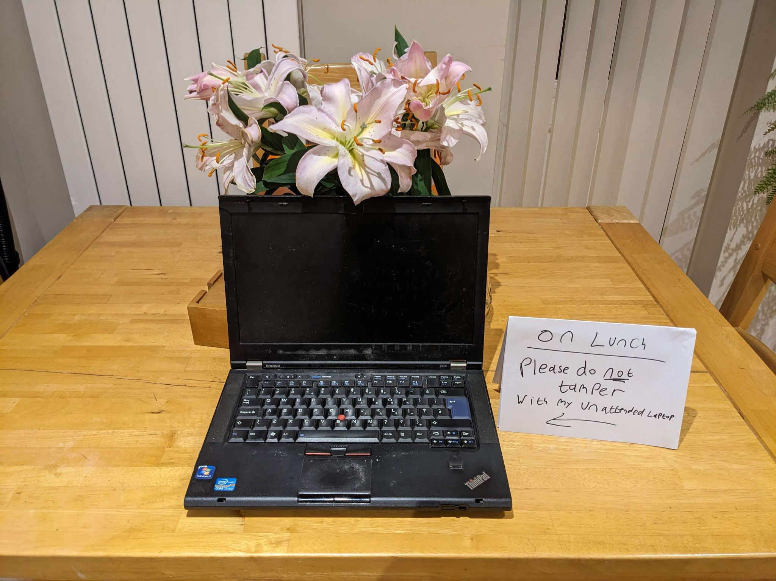

Slide 8
Refresher - “The Boot process ~ BIOS”
Basic Input Output System
Power button
Initialise hardware
Load Config
More Initialisation
init!
Motherboard
Search for MBR
Load Kernel
Mount root filesystem*
Start Services
BIOS POST
Load Bootloader
Load initramfs*
Switch root*
GUI

Slide 9
RIP BIOS -> Enter UEFI
Unicorn
Enchanted
Fairy
Interface
Unified
Extensible
Firmware
Interface
Because no one knows how it works! But by the end of this talk you’ll know it’s the…

Slide 10
Refresher - “The Boot process ~ UEFI”
Power button
Initialise hardware
Load Config
More Initialisation
init!
Motherboard
FAT Filesystem Support!
Load Kernel
Mount root filesystem*
Start Services
UEFI POST
Load config from NVRAM
+
Run EFI Executables
Load initramfs*
Switch root*
GUI

Slide 11
Refresher - What can the Evil maid tamper with?
Power button
Initialise hardware
Load Config
More Initialisation
init!
Motherboard
FAT Filesystem Support!
Load Kernel
Mount root filesystem*
Start Services
UEFI POST
Load config from NVRAM
+
Run EFI Executables
Load initramfs*
Switch root*
GUI
Firmware
On Disk

Slide 12
Refresher - Let's Protect that Disk!
Full Disk Encryption
Windows - Bitlocker
Mac - Filevault and T2
Self Encrypting Drives - OPAL
Linux - cryptsetup - LUKS / dm-crypt / truecrypt

Slide 13
Refresher - Let's Protect that Disk!
Linux LUKS
Linux Unified Key Setup
Is the standard for disk encryption on Linux
Standard Header + Key Slots + Encrypted data = LUKS Container
LUKS V2 supports JSON Metadata
One Master Encryption key -
0-7 “Keyslots” for different passwords or devices for unlock
Supports strong standards for data encryption and Key derivation (brute force protection)
Anti Forensics Striping
Generated at device creation
https://cdn.kernel.org/pub/linux/utils/cryptsetup/LUKS_docs/on-disk-format.pdf

Slide 14
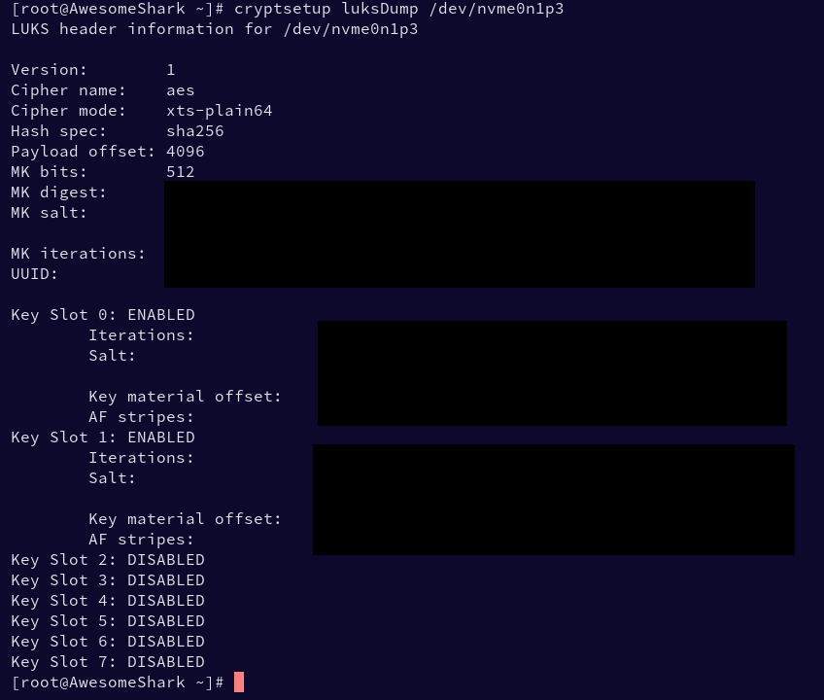
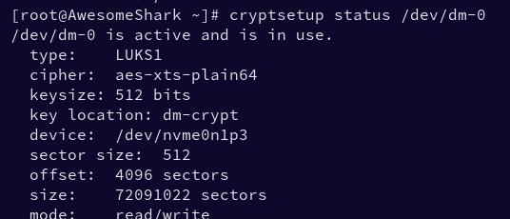
Refresher - Let's Protect that Disk!
Linux LUKS

Slide 15
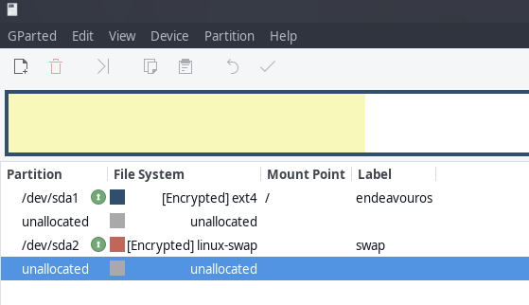
Refresher - Let's Protect that Disk!
The Whole Disk???
Endeavouros
(Arch Based Linux)
Encrypts the entire disk
OS + SWAP Space
Bootloader is GRUB with LUKS Support
GRUB unlocks the LUKS partition then loads the kernel + initramfs

Slide 16
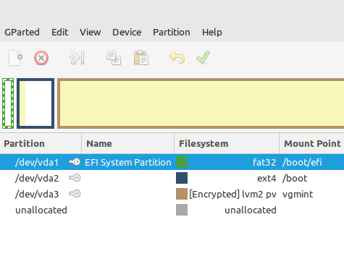
Refresher - Let's Protect that Disk!
The Whole Disk???
Linux Mint
(Ubuntu Based Linux)
Encrypts root file system
/boot filesystem left unprotected
Bootloader is GRUB
GRUB loads the kernel + initramfs
Initramfs unlocks LUKS container for the root Filesystem
*more common approach*
Redhat
Ubuntu
Etc
Chosen distro for this talk

Slide 17
Refresher - initramfs
The Initial RAM Filesystem
Uses the “cpio” file format (3 of them stuck together)
A small filesystem containing tools to help initialize the system and access the root device before the boot process is passed over to init
A collection of Scripts, binaries and “hooks”
Plymouth splash screen management
Can be used to setup RAID devices
Used to ask for the LUKS password and unlock the device

Slide 18

Refresher - What have we protected?
Power button
Initialise hardware
Load Config
More Initialisation
init!
👀
Motherboard
FAT Filesystem Support!
Load Kernel
Mount root filesystem*
Start Services
UEFI POST
Load config from NVRAM
+
Run EFI Executables
Load initramfs*
Switch root*
GUI
Firmware
On Disk

Slide 19
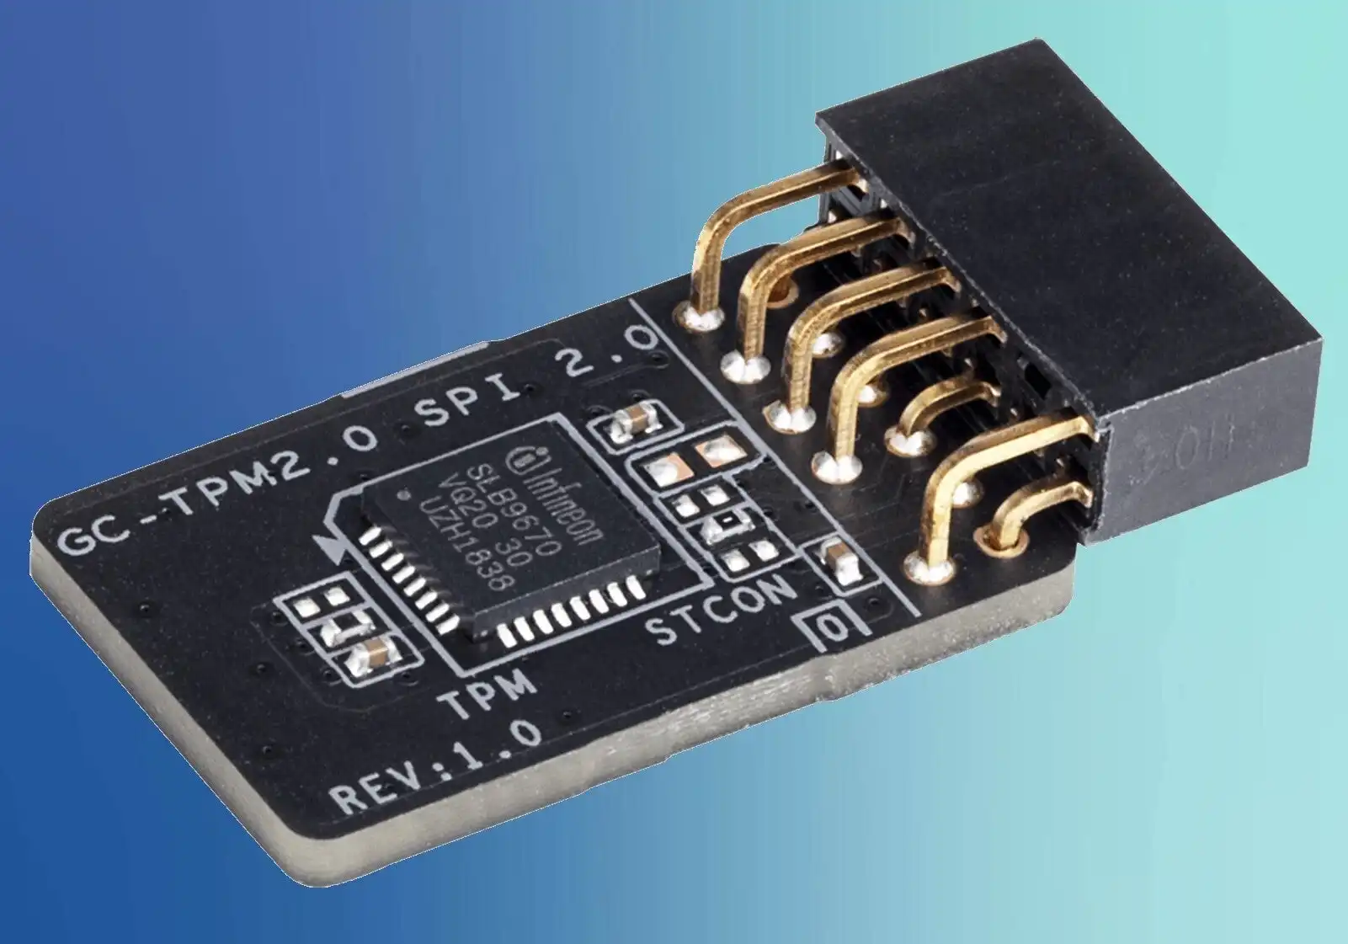
Refresher - Trusted Computing
TPM + Trusted Boot
TPM - Trusted Platform Module (1.2 + 2.0)
“A hardware solution to a software problem”
Root of trust
External device which can’t be tampered with by software
Secure storage location for crypto keys and processing
NOT a HSM
Insecure communication to CPU (SPI / LPC) (sometimes*)
pTPM vs fTPM vs vTPM vs CPU
Provides brute force protection
User presence
Privacy concerns + “reset” feature
https://learn.microsoft.com/en-us/windows/security/hardware-security/tpm/tpm-fundamentals

Slide 20
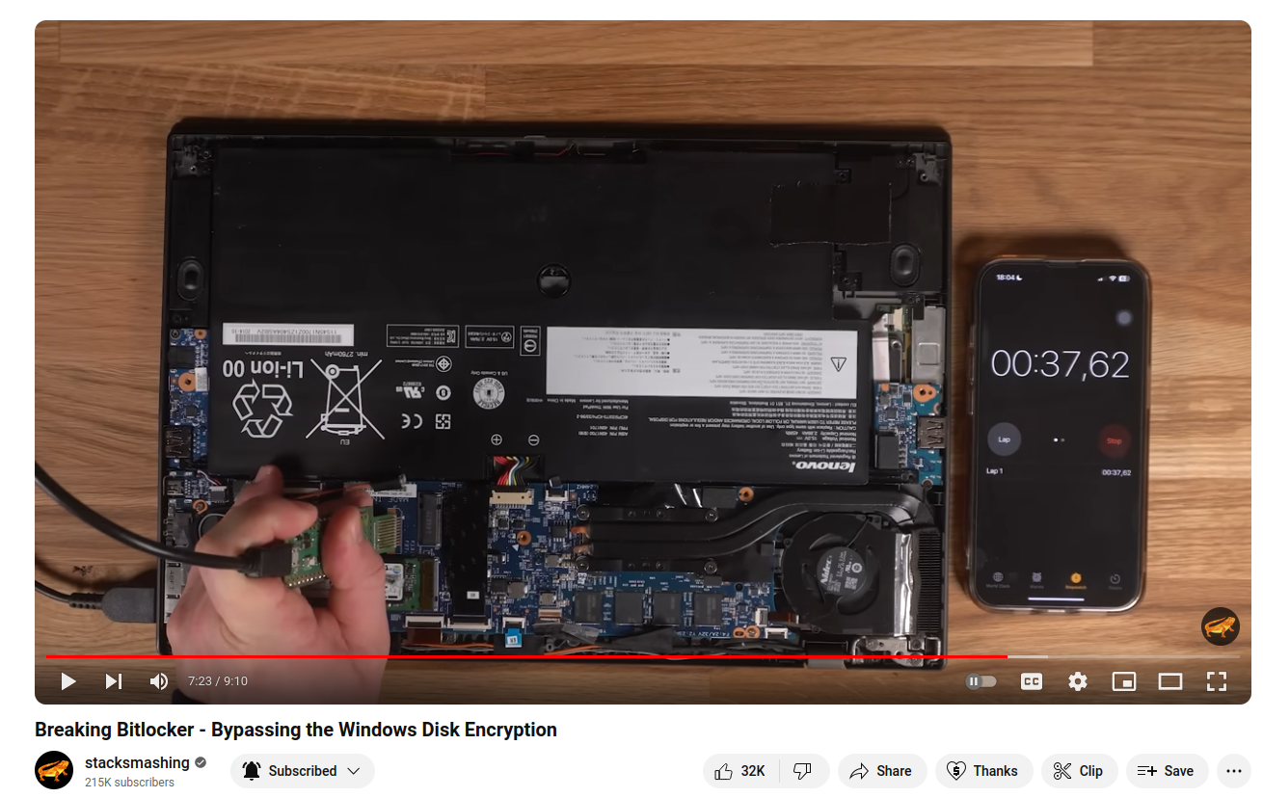
Refresher - Trusted Computing
TPM + Trusted Boot
Bitlocker defaults (on all devices) to TPM only protection!
TPM + PIN would prevent this
Or use a Integrated TPM in later Intel / AMD chips
Great video by
“Stacksmashing”
Demoing reading Bitlocker encryption keys off the LPC bus during boot
https://www.youtube.com/watch?v=wTl4vEednkQ

Slide 21
Refresher - Trusted Computing
TPM PCR
A Platform Configuration Register (PCR)
Can’t be reset*
Expanding SHA1 hash (always current hash + new data = new register PCR value)
DIfferent Registers can store different state
Stored Measurement Log provides cryptographic attestation of the PCR values using the TPMs unique key
Could be used to measure …. Firmware and kernels….
https://learn.microsoft.com/en-us/windows/security/hardware-security/tpm/switch-pcr-banks-on-tpm-2-0-devices

Slide 22
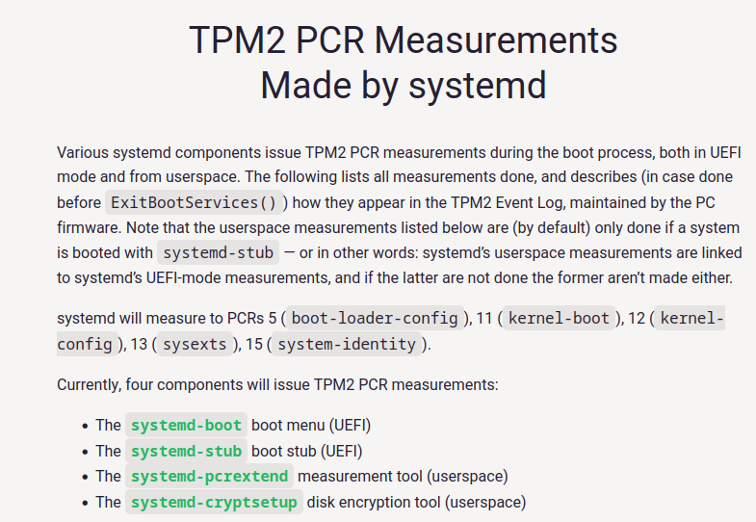
Refresher - Trusted Computing
TPM PCR
https://systemd.io/TPM2_PCR_MEASUREMENTS/

Slide 23
Refresher - Trusted Computing
TPM Bind vs Seal
TPM can hold encryption keys and act as a PKCS11 interface
Each TPM has a unique storage root key which is used to encrypt data provided to it
Bind = Encrypt this data just for the TPM
Seal = Perform a Bind but also only decrypt the data under specific circumstances eg PCR values
LUKS password can be SEALed and only unlocked when the boot process is fully validated and not tampered with!
https://learn.microsoft.com/en-us/windows/security/hardware-security/tpm/tpm-fundamentals

Slide 24
Refresher over! Let's put it all together :D

Slide 25
The perfect Linux world / “Windows!?!?”
Power button
Initialise hardware
Load NVRAM
Run EFI Binary + Update TPM
Mount rootfs + switchroot
Motherboard
TPM reads UEFI firmware + Updates PCR
Read EFI Binary and feed to TPM
Unified Kernel (systemd-stub) + embedded Initramfs
Init! +
Start Services
TPM Boot + PCR at 0
UEFI POST
Check digital signature of EFI binary
More initialization + Verify Boot via Stored measurement log -> unlock LUKS
GUI

Slide 26
The real world is messy
kernel + initramfs -> unlock and
Mount rootfs + switch root
Power button
Initialise hardware
Load NVRAM
Run EFI Binary
Motherboard
TPM reads UEFI firmware + Updates PCR
Read EFI Binary and feed to TPM
The SHIM + validate next stage
Init + Start Services
TPM Boot + PCR at 0
UEFI POST
Check digital signature of EFI binary
Grub
GUI

Slide 27
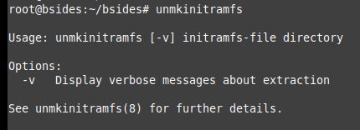
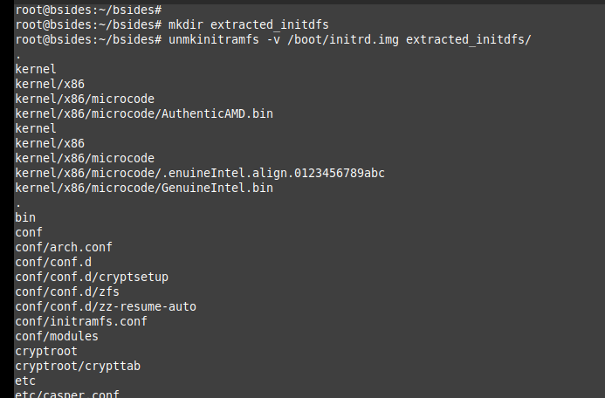
Initramfs - Still a great target for a threat actor!
How can we backdoor it?
Boot off a external linux install
Mount the disk
Unmkinitramfs to pull it apart
Inject backdoor
Re-asemble with cpio
Unmount device
~30 sec on modern hardware

Slide 28
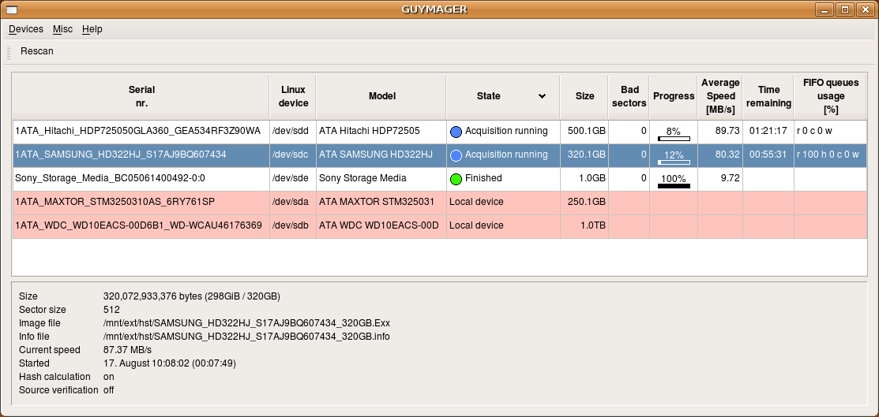
Let's Give it a go!
Wear your best maid outfit
Clone the users access card (mifare, nfc, RFID, etc)
Gain access to their room
Pull Out their hard drive / SSD
Clone their disk using Guymager in EWF Encase format
Insert a USB memory stick and boot off it
Run automated script to tamper with their initramfs

Slide 29
Let's Give it a go!

Slide 30
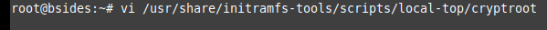
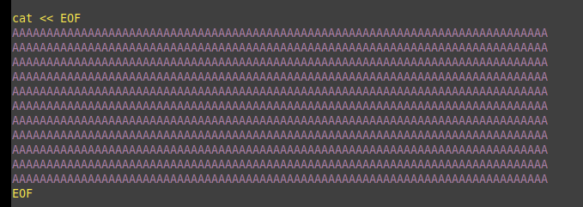
Let's Give it a go!

Slide 31
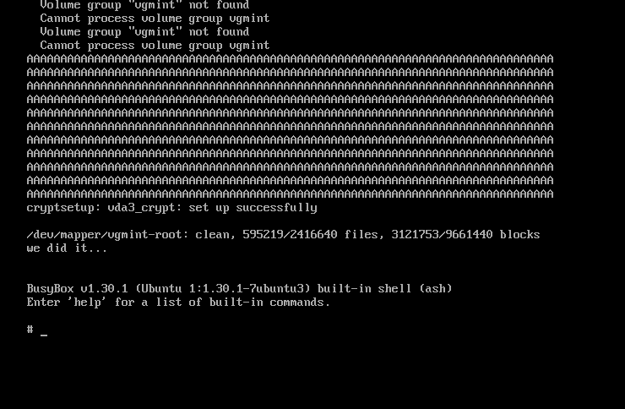
Let's Give it a go!

Slide 32
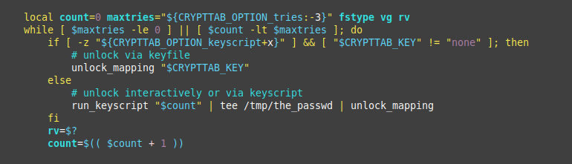
Let's Give it a go!

Slide 33
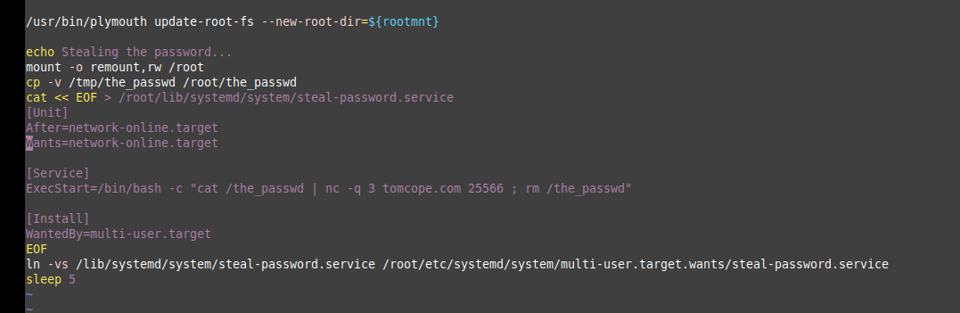
Let's Give it a go!

Slide 34
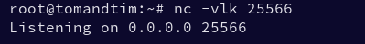
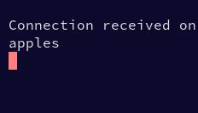
Let's Give it a go!
<3 best password

Slide 35
Let's Give it a go!
Now we have the password we can decrypt the cloned disk
We can even dump the LUKS master key!
Steal their laptop at a later time and even if they change their encryption password we still have access to the data

Slide 36
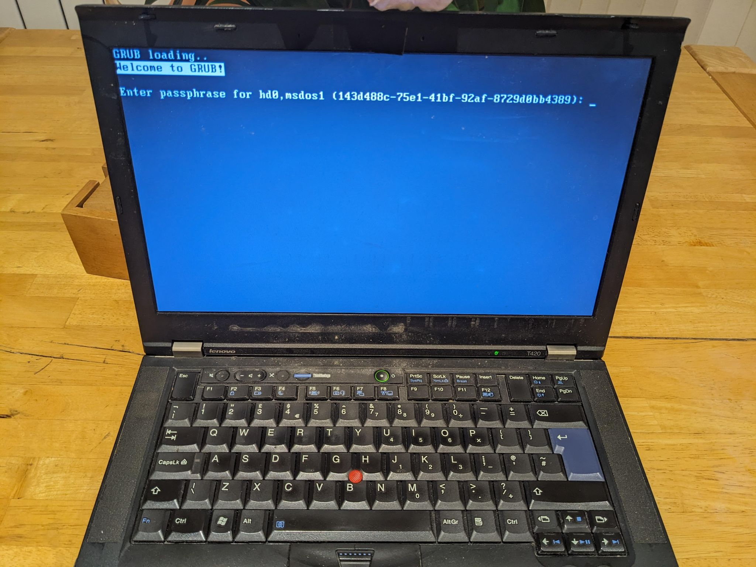
Demo!

Slide 37

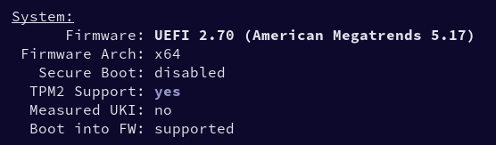
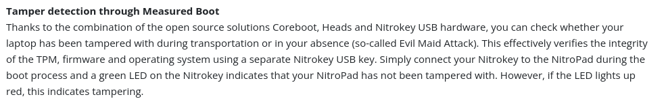
Mitigations
“True” Full disk encryption with correctly configured Trusted boot
Windows + MacOS
Linux with some tuning
UFEI Passwords help
External NitroKey validation

Slide 38
Questions?

